Slide 1
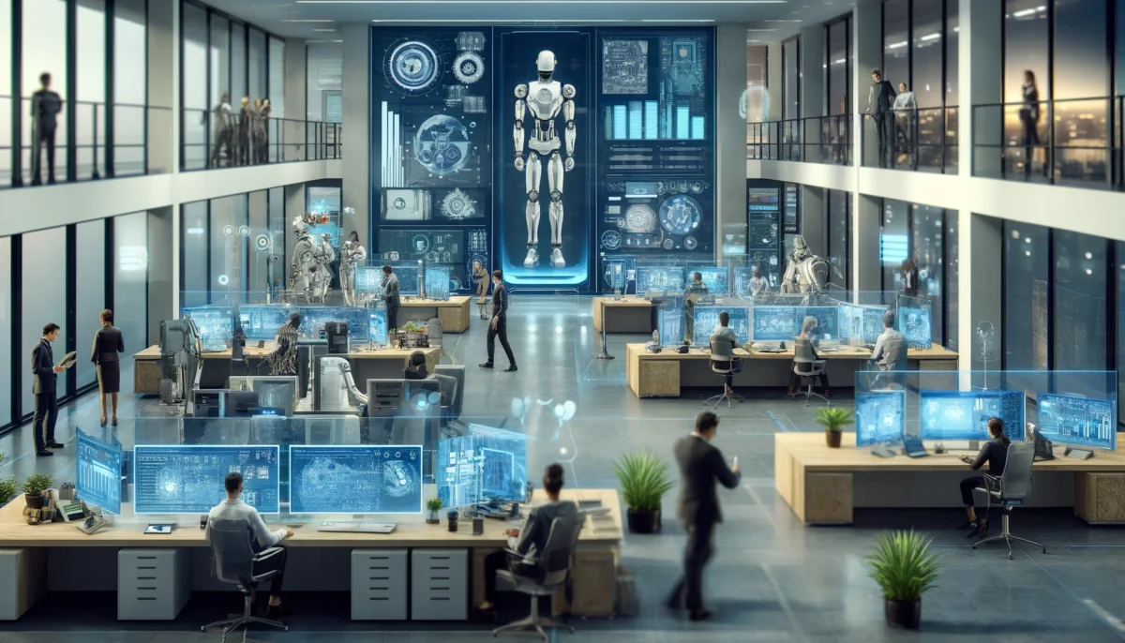
Artificial Intelligence in Takaful
ADAPTING WISELY, PRESERVING VALUE
© Frederik Bisbjerg, October 2025

Slide 2
Agenda
World 4.0
GenAL, LLMs, agents…
AI in Takaful
Working with AI
Planning change

Slide 3

22+ YEARS OF Shaping the future of insurance
>10
Years as industry partner
>12
Years leading the industry
Industry contributions:
AWARD-WINNING AUTHOR
C-level, global TPA
Senior leader, top-tier consulting firm
Co-founder, MBA in digital insurance
Non-Exec Director, Global Assn. of InsurTek professionals
Dy-CEO, leading AI & Big Data provider
EVP, Retail & SME
Chief Transformation Officer
Chief Operations Officer
Chief Executive Officer
Keynote speaker
Author – industry thought leadership
Lecturer
Industry influencer
150+ industry recordings & teachings
Hosting the region’s first AI Academy for insurers
WORLD CIO OF THE YEAR
DIGITAL INSURER OF THE YEAR
FREDERIK BISBJERG

Slide 4
World 4.0

Slide 5
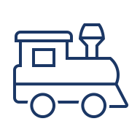



The four industrial revolutions
First industrial revolution (c. 1760–1840)
Second industrial revolution (c. 1870–1914)
Third industrial revolution (digital, 1970s- )
Fourth industrial revolution (GenAI, robots)
Introduction of steam power and mechanized production - humanity's first major
leap from manual labor to machine-assisted work
Mass production, electricity, and steel transformed society from agricultural to industrial,
creating the foundation of modern urban life.
The digital age transformed information processing and communications, shifting economic value from physical production to knowledge work
Artificial intelligence and interconnected systems are now automating cognitive work itself, representing the most profound transformation yet in
Steam power and mechanized textiles displaced artisan weavers; real wages for hand-loom workers halved over three decades.
Electrification, mass steel, and the assembly line cut demand for bespoke crafts and farm labor; ~11 million Americans left agriculture for city factories.
Routine clerical and assembly roles gave way to automation; job polarization emerged
Up to 57 % of OECD jobs face high automation risk – 78 million jobs
Disruption
Britain's textile workforce doubled from ~168kin 1788 to
~336k by 1820, while entirely new trades - mechanics, ironworkers, railway crews -appeared
U.S. employment 4x’d from 3.5 m to 14.2 m (1870-1910); new industries like telephony added ~178,000 operators by 1920
Millions of software developers, IT architects, cybersecurity analysts, and digital marketers entered the labor market
69 % of leaders expect net job growth from 4IR technologies. AI specialist hiring in insurance has grown 74 % annually since 2018.
Job creation
Effect
Total employment and GDP per capita rose steadily
Rapid economic growth, rise of the managerial class and white-collar services
Knowledge-economy expansion offset routine-task losses, though skewed to high-skill roles
Early data already show parallel elimination and creation, repeating the historical pattern

Slide 6
GenAI, LLMs, agents…

Slide 7




The hype is real
AI in the media
“UAE: 6 in 10 employees will need reskilling as AI enters workplace”
Short run (today): AI is already eating routine insurance tasks — claims triage, document review, underwriting checks. Humans are pushed toward novel or judgment-heavy cases.
Long run (next few years): Routine work disappears, AI dominates the mid-tier, and human specialists survive only by moving to the edges (novel, creative, relationship-driven).
Career impact: The biggest risk isn’t being “replaced” but being left behind while others learn to work with AI — stagnation is as dangerous as automation.
Organisational imperative: Leaders who redesign roles, processes, and training now will capture the gains; those who delay will lock their firms into inefficiency.
Top priorities in the next 6-12 months for the workforce:
Collaborating with technical departments in designing and deploying AI tools and policies
Mapping the impact of AI on people, jobs, tasks and processes
Proactively redesigning jobs, tasks and processes
Developing upskilling and reskilling programs
Hiring new, specialized talent with skills to work alongside, or design, AI tools
Facilitating talent redeployment and internal mobility
Leading the design and execution of change management programs
Measuring productivity and performance changes
Managing workforce downsizing in obsolete roles
Top risks: Employees not adapting fast enough, career stagnation / skill loss, ethical and data privacy issues. ￼
Decline in entry-level employment in high AI-exposed occupations
Stagnation of job growth for young workers generally since late-2022
“
“Business acumen and strategic thinking” are ranked as essential success factors for people leaders.

Slide 8
What is the hype all about – the path to AGI – artificial general intelligence
The path to AGI
DETERMINISTIC MODELS
PROBABILISTIC MODELS
“The recipe”
“the apprentice”
“the assistant”
“the creator”
“the vision”
Programming
Machine learning (ML)
Artificial intelligence (AI)
Generative AI / LLMs (GenAI)
Artificial general intelligence (AGI)
Computers follow rules humans write
Example: “If a claim is above AED 50,000, flag it.”
Instead of rules, the computer learns patterns from data.
Example: It looks at thousands of past claims to predict which ones are likely fraudulent.
A broad term for systems that mimic parts of human thinking — like answering questions, recognizing images, or guiding decisions.
Example: A chatbot giving standard policy answers.
The new leap: AI doesn’t just follow or predict, it creates. It can draft reports, write emails, summarize legal text, or even generate repair estimates.
Still in the future: an AI that can learn and reason across all tasks like a human — from negotiation to diagnosis to strategy.
AI automates decisions with predefined rules, while ML continuously learns from data

Slide 9
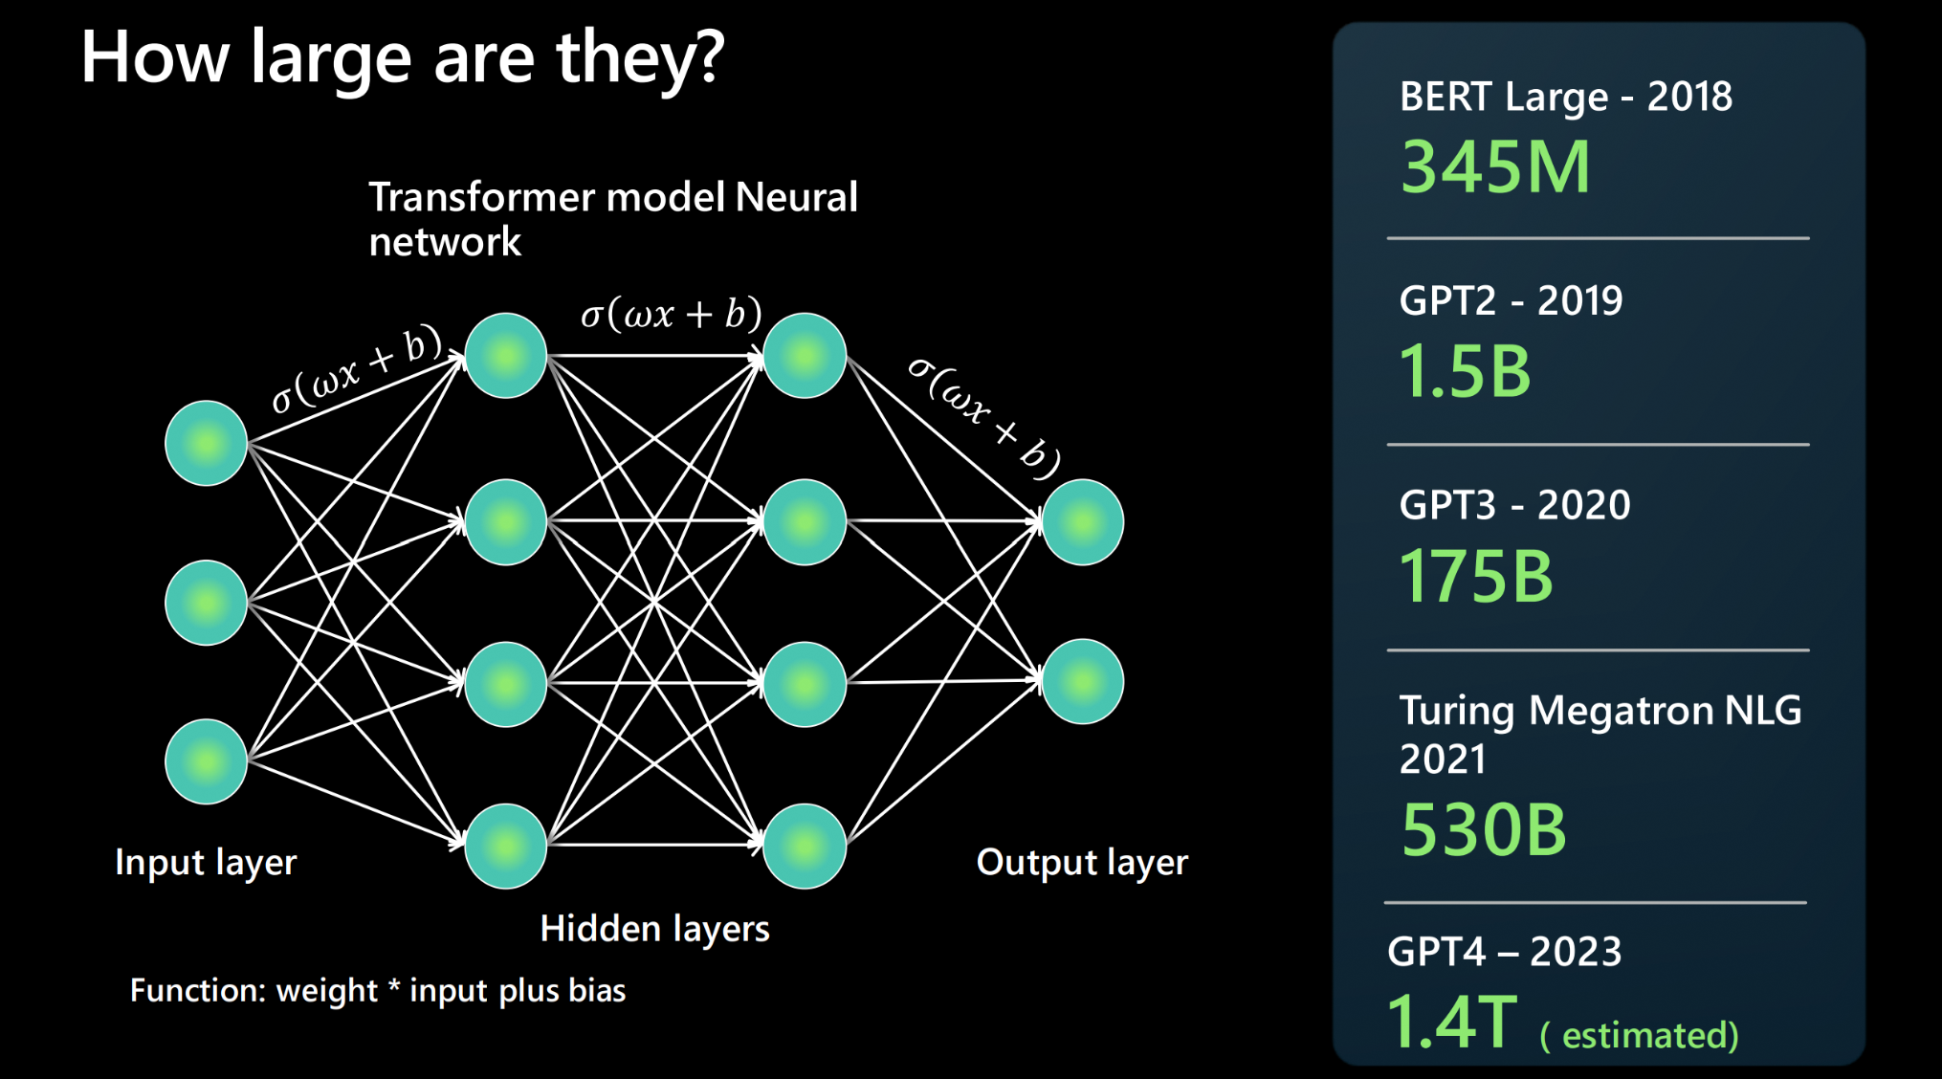
A Large Language Model (LLM) is a type of artificial intelligence trained on vast amounts of text to recognize patterns in how humans use language
Large Language Models
How it works in practice
Input (prompt): A user provides an instruction or question, such as “Summarize this motor claim in 3 bullet points.”
Processing: The LLM draws on patterns from billions of examples to predict the best response
Output: A structured, human-like answer — summary, explanation, draft, or analysis
What it DOES NOT:
Does NOT Understand language. It's just a predictive engine. Based on text patterns it has previously seen, it can predict completions for the given text input
Does NOT Understand facts. There are no separate 'modes' for information retrieval vs. creative writing. The model just predicts the next most probable token in the ongoing sequence.
Does NOT Understand manners, emotion or ethics. The output is the outcome of training data guided by the given prompts.

Slide 10
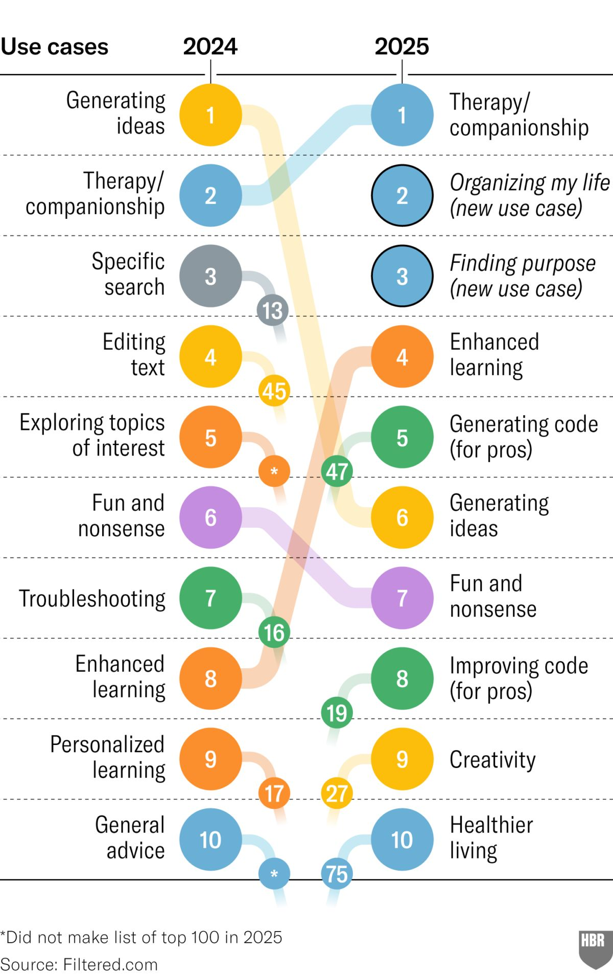
Today’s GenAI is like having a country of geniuses in a data center – but still not widely adopted as such – use cases are still mostly personal
GenAI usage
1. Strategic foresight Input:
“Analyze how the rise of Chinese EV brands in the UAE will impact motor insurance claims costs over the next 3 years. Suggest actions insurers should take.”
2. Complex scenario modeling Input:
“Given a portfolio of 10,000 motor policies with an average premium of AED 2,500 and an expected claim frequency of 20%, simulate how introducing telematics discounts would affect profitability.”
3. Regulatory impact Input:
“Summarize the key risks for UAE insurers if the Central Bank mandates AI explainability in claims decisions and propose 3 governance measures to comply.”
AI: A country of geniuses in a data center
“Genius on Demand- The Value of Transformative Artificial Intelligence”
Angle for executives:
Don’t think of GenAI as just automating admin tasks. Think of it as giving your company access to genius on demand.

Slide 11
Giving the insurance organization superpowers with GenAI
The GenAI wall study
Distant outsiders
Distant outsiders
The GenAI wall
Adjacent outsiders
Adjacent outsiders with GenAI
‘Insiders’ – domain specialists
‘Insiders’ – domain specialists
Insider | Adjacent outsiders – share foundational knowledge
Underwriting | Product Development, Claims, Sales & Distribution
Compliance & Governance | Product, Legal, Finance
Claims Management | Underwriting, Customer Experience, Provider Management
“
When supported by GenAI, adjacent outsiders performed almost as well as insiders
They could reason, analyze, and articulate ideas that once sat just beyond their reach
Source: Harvard Business School: The GenAI Wall Effect

Slide 12
AI in Takaful

Slide 13
Use cases for AI in Takaful
GENERIC USE CASES FOR GEN-AI IN TAKAFUL
Marketing and sales
Document & data management
Customer
service
Operations
Technology and development
Data analytics
Compliance and audit
Lead generation, segmentation, and scoring
Content creation
Automated outreach
Document analytics
Data extraction and processing
Identity verification
Chatbots and virtual assistants
Policy administration
Personalized recommendations
Decision support / STP
Claims processing
Underwriting automation
Software development assistance
Documentation of legacy software
Process automation
Risk assessment and management
Fraud detection and prevention￼
Predictive analytics
Regulatory compliance
Real-time auditing of financial activities
Anomaly detection (process deviations)

Slide 14

Reasons for lack of AI adoption
AI adoption in the industry
Reasons for lack of GenAI adoption
Limited understanding of GenAI (probabilistic vs. deterministic)
VERY few implemented use cases
Several POCs (sandbox and testing)
Most operational implementations are AI or machine learning – not GenAI
Lack of clear use cases for GenAI across the organization
Operational GenAI is an IT project with integrations required to be successful
No GenAI capabilities in the company
Security concerns about data privacy and usage

Slide 15
Working with AI

Slide 16
Immediate opportunities with GenAI
ChatGPT as wall-breaker
ChatGPT as daily optimizer

Slide 17
Agility for free: breaking down the walls with GenAI
ChatGPT as wall-breaker
Make use of the “country of geniuses in a data center”
Today
Insurers operate in silos: legacy systems, rigid hierarchies, and risk-averse cultures isolate teams
Underwriters rarely see claims outcomes; claims teams don’t understand pricing logic
Knowledge stays trapped, slowing decisions and stifling innovation
Breaking down the walls
ChatGPT enables leaders to cross departmental lines by asking smart questions and refining AI output with experience
Knowledge starts moving sideways, not just up and down
Collaboration strengthens, communication speeds up, and insurers become agile without reorganization
Scale
ChatGPT lets employees automate or accelerate 60–70% of daily work
The remaining time becomes exponentially more valuable - one person can handle what used to take three
Output grows without adding headcount, and over time, fewer people deliver the same results
Agility
When knowledge flows freely, teams can shift capacity in days, not months
Generative AI allows “adjacent outsiders” from other departments to step in and contribute drafts, analyses, or reviews
Insurers respond faster to market shifts or new regulations because everyone can help adapt processes and materials at speed

Slide 18
Opportunities
Administrative tasks: report writing, summarizing, note taking.
Estimation of damage from photos (auto body) — with human verification.
Fraud detection, underwriting risk scoring: analysts explore using predictive tools.
Loss control: risk management reports, underwriting risk with AI assistance.
Customer communication: drafting letters/emails, customer support with human oversight.

Slide 19

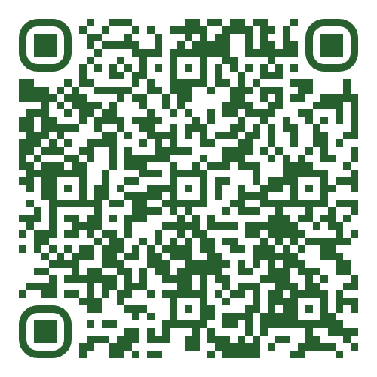

Identifying use cases for GenAI, using ChatGPT
Workshop
ChatGPT expert
Spot Pain Points in Your Work
Where do we repeat tasks again and again?
Where do things slow down or wait for manual checks?
Where do customers get frustrated or wait too long?
Write a Simple Problem Statement
Use plain business language (no tech terms).
Keep it short (1–2 sentences).
Template:
“In my team, we struggle with [challenge].
This causes [impact].”
Examples
“Our claims staff spend hours typing in Emirates ID details → delays.”
“Motor underwriting is slow because referrals are checked manually via RTA.”
“Arabic-speaking customers can’t get quick support.”
Next Step: Enter your problem statement into ChatGPT
Web-version

Slide 20
From AI literacy to AI fluency
The 4 Layers of AI Literacy
Specific employees
AI system specific
Specific employees
Persona & role-based training
ALL
Mandatory training for individuals responsible for oversight and operation of high-risk AI.
Bespoke instructions, guidance, and resources on human oversight implementation and broader risk mitigation measures.
Essential for EU AI Act compliance: deployment and oversight of high-risk AI systems.
Generative AI empowerment
ALL
Tailored training for specific personas and teams, who build, buy, use, or govern AI.
Target key personas including legal, privacy, procurement, data scientists and AI engineers.
Must be engaging, hands-on, scenario-based, and relevant for the role.
Responsible AI fundamentals
Empower the workforce to embrace and adopt AI with confidence.
Provide actionable tips, frameworks, prompts, and case studies to promote AI use.
Educate the workforce on which AI tools, capabilities, and resources are available.
Mandatory AI training for the organization
Promote a baseline understanding of AI technology, risk, and governance fundamentals
Cover your internal AI governance framework, including practical Dos and Don’ts
1
2
3
4

Slide 21
Planning change

Slide 22
Reasons for failed change initiatives
Unclear goals
and priorities
Inadequate
communication
Rigid
systems
Lack of innovation
Inefficiency and wasted resources
Declining employee motivation
Stagnant progress
Competitive disadvantage
Erosion of leadership credibility
POOR CORPORATE
PERFORMANCE
Micro-
management
Fear of decision-
making
Competing
priorities
UNCLEAR GOALS AND PRIORITIES
No strategic alignment:
Teams work on disconnected initiatives
Shifting focus:
Priorities change too often
No clear success metrics:
Impact is hard to measure
Siloed decision:
Departments set conflicting priorities
No prioritization framework:
Efforts are spread too thin
Inadequate communication
Siloed teams: Departments work in isolation
No transparency: Unclear updates cause misalignment
Conflicting messages:
Priorities are misunderstood
Information overload:
Too much noise, not enough clarity
Strategy disconnect: Goals aren’t translated into action
MICRO-
MANAGEMENT
Bureaucratic bottlenecks:
Too many approvals slow progress
Lack of trust: Employees feel disempowered
Slow decisions:
Endless review cycles stall execution
Innovation paralysis: Over-analysis blocks bold moves
Low engagement: Talented employees disengage
FEAR OF DECISION-MAKING
Risk aversion:
Fear of failure prevents action
Analysis paralysis: Overthinking delays progress
No accountability: Tough decisions are avoided
Preference for the status quo:
Change is resisted
Missed opportunities: Waiting too long gives competitors an edge
Rigid systems and outdated policies
Inflexible IT:
Legacy systems block progress
Resistance to change:
Old habits slow transformation
Slow approvals: Bureaucracy hinders agility
One-size-fits-all rules:
Policies does not match evolving needs
Poor adaptability: Governance isn’t built for speed
Competing
priorities
Too many projects: Focus is scattered
Short-term focus: Firefighting trumps strategy
Resource drain: Teams are stretched too thin
Conflicting demands:
Different stakeholders push their own agendas
No project governance: No system to balance priorities

Slide 23


There’s only one path to successful change – and that require a holistic view on the whole organization
Successful organizational change
Vision
Skills
Incentive
Resources
Action plan
CHANGE
Vision
Skills
Incentive
Resources
Action plan
CONFUSION
Vision
Skills
Incentive
Resources
Action plan
ANXIETY
Vision
Skills
Incentive
Resources
Action plan
DELAYS
Vision
Skills
Incentive
Resources
Action plan
FRUSTRATION
Vision
Skills
Incentive
Resources
Action plan
FALSE STARTS
Source: The Digital Insurer, ADI, lesson 7.5, “Change as a discipline”

Slide 24

Thank you!

